Slide 1
Java vs. C#
IN610

Slide 2
Program Structure
Java
package hello;
public class HelloWorldApp {
public static void main(String[] args) {
String name = "Java";
System.out.println("Hello, " + name + "!");
}
}
C#
namespace Hello {
public class HelloWorld {
public static void Main(string[] args) {
string name = "C#";
System.Console.WriteLine("Hello, " + name + "!");
}
}
}

Slide 3
Importing Libraries
Both languages support this functionality and C# follows Java’s technique for importing libraries:
Java: import keyword
import java.util.*;
import java.io.*;
C#: using keyword
using System;
using System.IO;
using System.Reflection;

Slide 4
Comments
Java
C#
// Single line
/* Multiple
line */
/** Javadoc documentation comments */
// Single line
/* Multiple
line */
/// XML comments on a single line
/** XML comments on multiple lines */

Slide 5
Data Types
Java
C#
Primitive Types
boolean
byte
char
short, int, long
float, double
Value Types
bool
byte, sbyte
char
short, ushort, int, uint, long, ulong
float, double, decimal
structures, enumerations

Slide 6
Java
C#
Reference Types
Object
//superclass of all other classes
String
arrays, classes, interfaces
Reference Types
object
//superclass of all other classes
string
arrays, classes, interfaces, delegates

Slide 7
Java conversions
C# conversions
// int to String
int x = 123;
String y = Integer.toString(x);
// y is "123"
// String to int
y = "456";
x = Integer.parseInt(y);
// x is 456
// double to int
double z = 3.5;
x = (int) z;
// x is 3 (truncates decimal)
// int to string
int x = 123;
String y = x.ToString();
// y is "123"
// string to int
y = "456";
x = int.Parse(y);
// or x = Convert.ToInt32(y);
// double to int
double z = 3.5;
x = (int) z;
// x is 3 (truncates decimal)

Slide 8
Constants
Java
C#
final double PI = 3.14;
const double PI = 3.14;

Slide 9
Switch statements
Java (preview feature)
C#
color = "red";
switch (color)
{
case "red"-> r++;
case "green"->g++;
case "blue"->g++;
default-> other++;
}
System.out.println(r);
string color = "red";
switch (color) {
// Can be any predefined type
case "red": r++; break;
// break is mandatory; no fall-through
case "blue": b++; break;
case "green": g++; break;
default: other++; break; // break necessary on default
}

Slide 10
For each loops
Java
C#
for (int i : numArray)
sum += i;
foreach (int i in numArray)
sum += i;

Slide 11
Arrays
Java
C#
int[] nums = {1, 2, 3};
or
int nums[] = {1, 2, 3};
for (int i = 0; i < nums.length; i++)
System.out.println(nums[i]);
String names[] = new String[5];
names[0] = "David";
int[] nums = {1, 2, 3};
for (int i = 0; i < nums.Length; i++)
Console.WriteLine(nums[i]);
string[] names = new string[5];
names[0] = "David";

Slide 12
Properties
Java:
public int getSize()
{
return size;
}
public void setSize(int val)
{
size = val;
}
C#:
public int Size
{ get {return size;}
set {size = val; }
}

Slide 13
Inheritance
C# uses C++ syntax for inheritance, both for class inheritance and interface implementation as opposed to the extends and implements keywords.
Java:
class B extends A implements Comparable
{ ……………
……………
}
C#:
class B:A, IComparable
{ …………
…………
}

Slide 14
The same
Operators
If statements
For loops
While loops
Do ..while loops

Slide 15


Slide 16
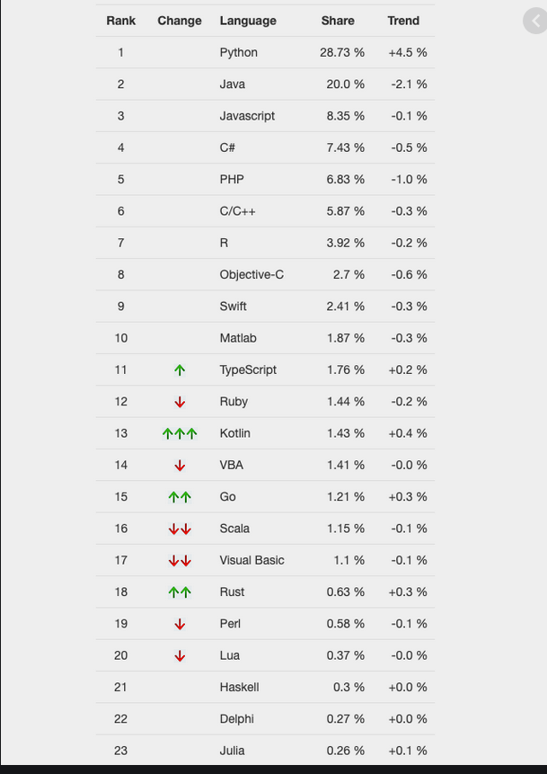

Slide 17
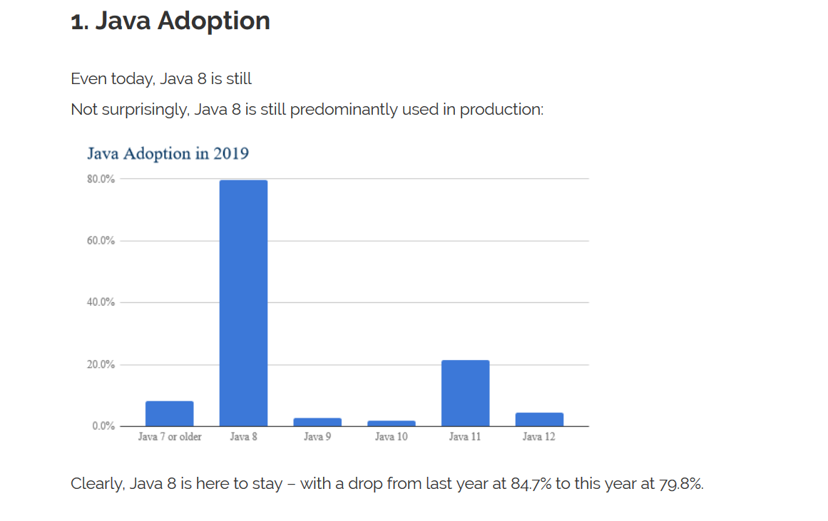

Slide 18
